Slide 1

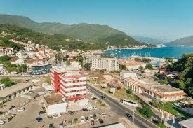
Welcome to
Faculty of Management
Herceg Novi

Slide 2
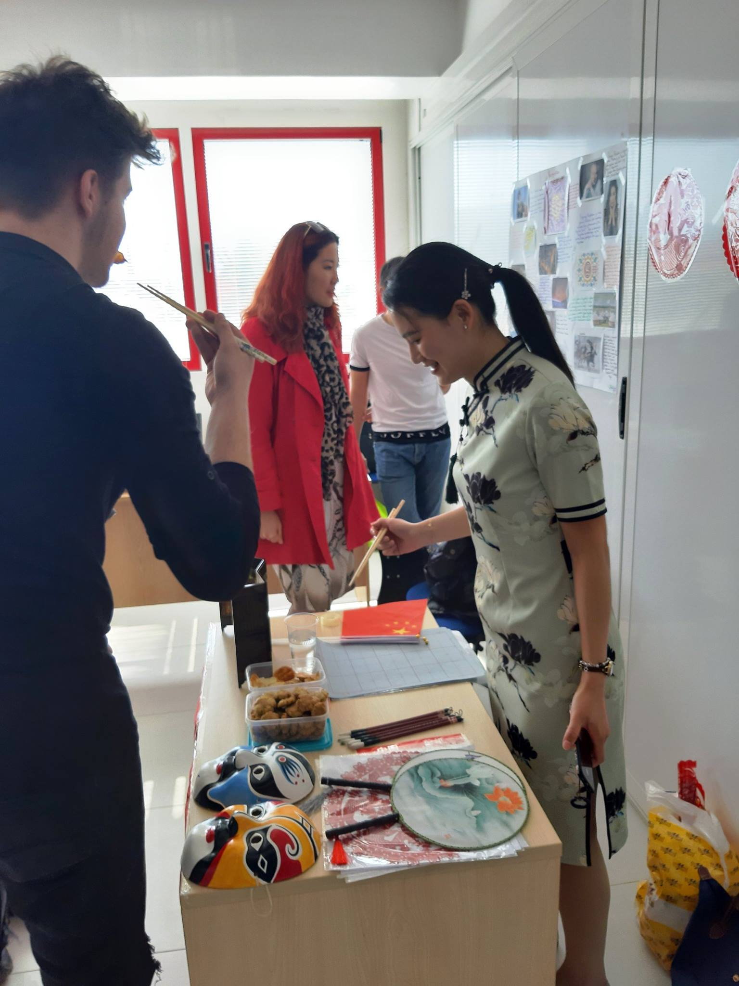
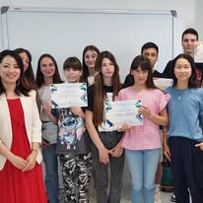
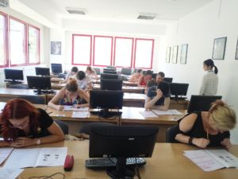
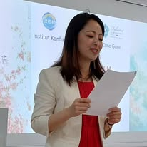
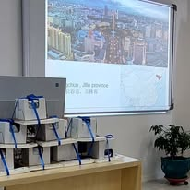
Confucius Classroom at FMHN
Established as a hub for Chinese language and culture in the Boka region
Organizes not only Chinese language courses, but also cultural and academic events
Strengthens educational and cultural ties between Montenegro and China
https://www.fm-hn.com/kursevi/centar-za-strane-jezike/institut-konfucije-kineski-jezik/

Slide 3



Free Chinese Language Courses
Regularly organized at FMHN Confucius Classroom
Courses promoted via website and media
Online registration available for all interested participants
https://www.fm-hn.com/kursevi/centar-za-strane-jezike/institut-konfucije-kineski-jezik/

Slide 4
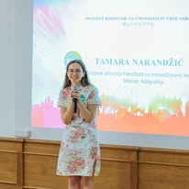
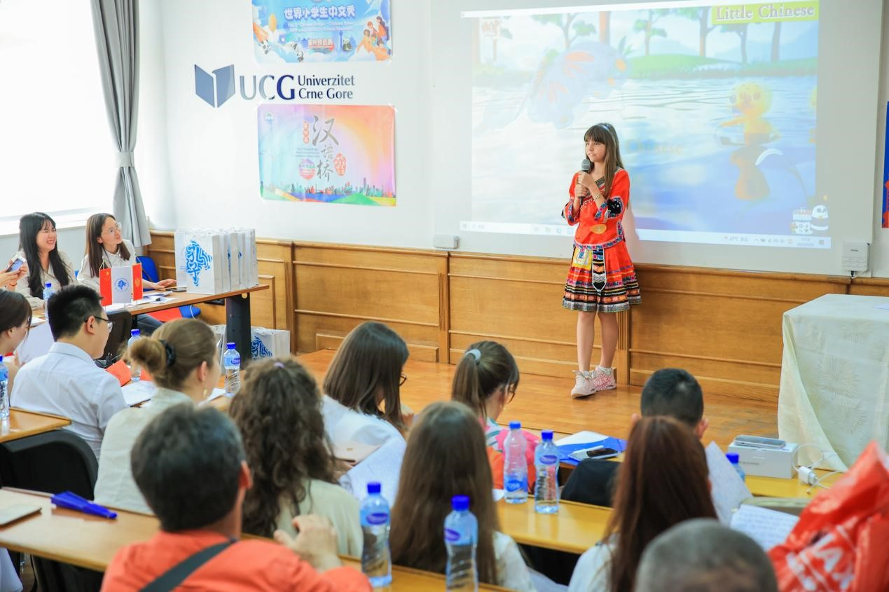
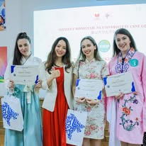
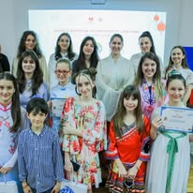
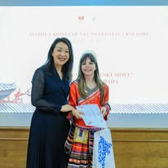
Achievements of Our Students: Success at “Chinese Bridge” Competition
  FMHN Confucius Classroom students won first prize in the university category at the Chinese Bridge competition (2023)
  One of our proudest achievements is the success of our students at the Chinese Bridge competition. In 2023, students from the Confucius Classroom at the Faculty of Management Herceg Novi won the main prize in the university category at the preliminary competition in Montenegro. This outstanding result highlights both the high quality of teaching in our Confucius Classroom and the dedication of our students. Their success also contributes to strengthening Montenegro’s presence and reputation in international academic and cultural competitions.
  https://www.fm-hn.com/2024/10/14/besplatan-kurs-kineskog-jezika/?utm_source=chatgpt.com

Slide 5

Cultural Events & Activities
In addition to language teaching, FMHN has organized several cultural events to bring China closer to our local community. One notable example is the art contest ‘China as Inspiration’ for students from the Boka region, carried out in collaboration with the Confucius Institute. Many beautiful drawings and graphic works from young participants were submitted — highlighting the interest and creativity sparked by Chinese culture
We have also hosted Chinese Culture Days and similar events to celebrate traditions, arts, music, and cuisine, engaging both our students and the broader community. These activities demonstrate that our Confucius Classroom is not only an educational platform, but also a bridge for cultural dialogue.
https://www.fm-hn.com/2021/11/03/konkurs-za-najljepse-crteze-graficke-i-likovne-radove-u-saradnji-sa-institutom-konfucije/

Slide 6
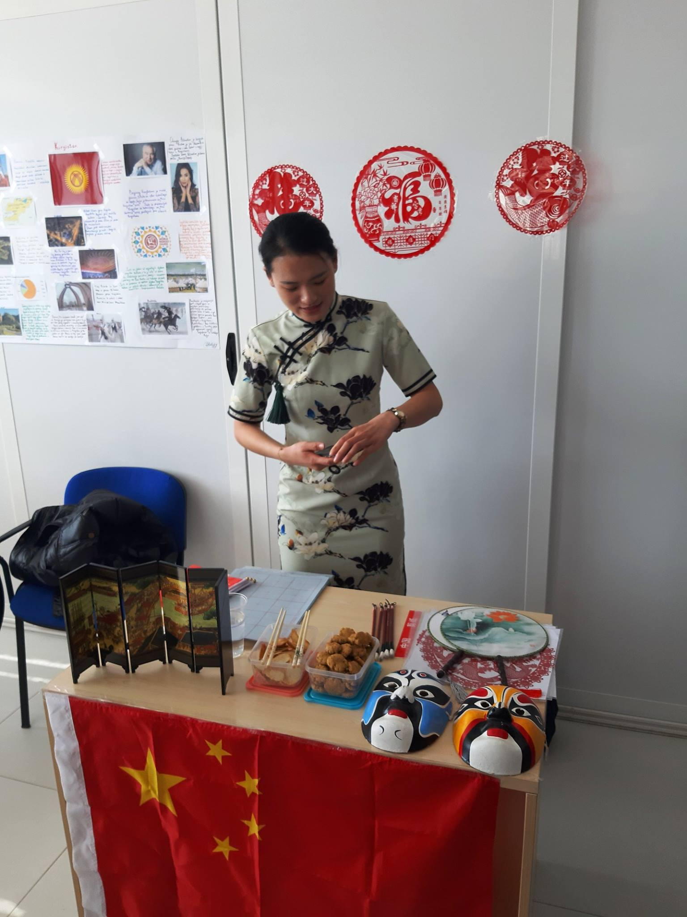
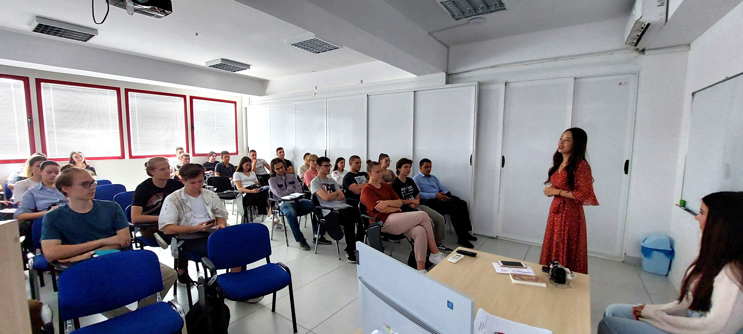
China as Inspiration

Slide 7
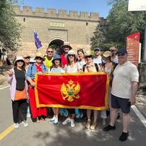
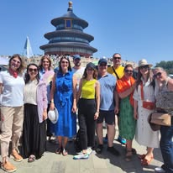
International Cooperation: Participation in the Chinese Bridge educational and cultural program in China (July 2023)
In July 2023, a Montenegrin delegation of students and staff participated in the educational and cultural program Chinese Bridge in China. This visit, organized in cooperation with the Confucius Institute at the University of Montenegro, the Center for Cooperation and Education of Chinese and Foreign Languages, and Changsha University of Science and Technology, gave our delegation the opportunity to experience China’s scientific and cultural achievements first-hand.
This program highlighted the great potential for future cooperation in the field of education and reinforced our commitment to building stronger academic and cultural ties between Montenegro and China.
https://www.fm-hn.com/2023/07/21/crnogorska-delegacija-posjetila-kinu-veliki-potencijal-za-saradnju-u-oblasti-obrazovanja/

Slide 8
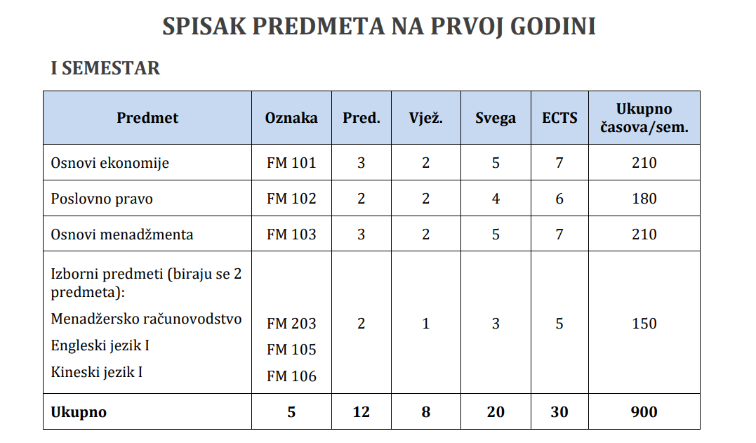
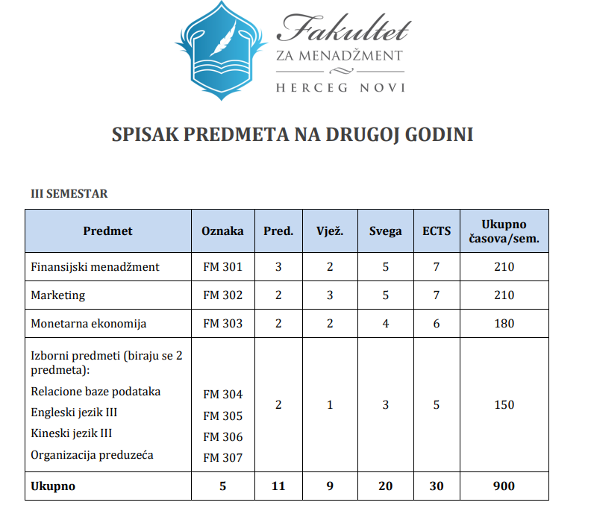
Chinese Language in Regular Curriculum
At the Faculty of Management Herceg Novi, the Chinese language has been integrated directly into our official curriculum. In the first year, students take Chinese I and II, while in the second year they continue with Chinese III and IV.
This makes our Faculty unique in Montenegro, as Chinese is taught alongside English as a regular part of the study program. By including Chinese in our curriculum, we provide students with valuable skills that will help them build careers in international business, tourism, and academic cooperation with China
https://www.fm-hn.com/wp-content/uploads/2025/09/Nastavni-plan-I-god.pdf
https://www.fm-hn.com/wp-content/uploads/2025/09/Nastavni-plan-II-god-1.pdf

Slide 9
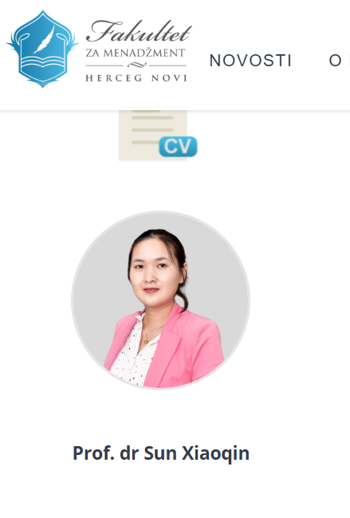
Research and Visiting Professors: Academic Cooperation with Chinese Universities
Our cooperation with Chinese universities extends beyond language teaching. Some of our staff members have conducted research in cooperation with Changsha University of Science and Technology, further strengthening academic ties.
We are also proud to host visiting professors from China at FMHN. Among them is Prof. Dr. Xiaoqin Sun, who not only lectures at our Faculty but also serves as a member of the Scientific Board of the COAST International Conference, which FMHN organizes every year.
These exchanges bring valuable expertise, support our international orientation, and provide our students with unique opportunities to learn directly from distinguished Chinese scholars.
https://www.fm-hn.com/wp-content/uploads/2020/02/Sun-Xiaoqin_CV-with-Photo.pdf

Slide 10
Future Cooperation
Looking ahead, we see great potential for expanding our cooperation with Chinese partners. Our main expectations include organizing short-term study visits for both students and staff to experience China’s achievements in science, education, and culture.
We also wish to develop structured exchange programs for students and professors, enabling knowledge-sharing and deeper intercultural understanding.
Finally, we look forward to launching joint scientific, cultural, and educational projects that will not only strengthen the partnership between FMHN and Chinese institutions but also contribute to building lasting ties between Montenegro and China

Slide 11
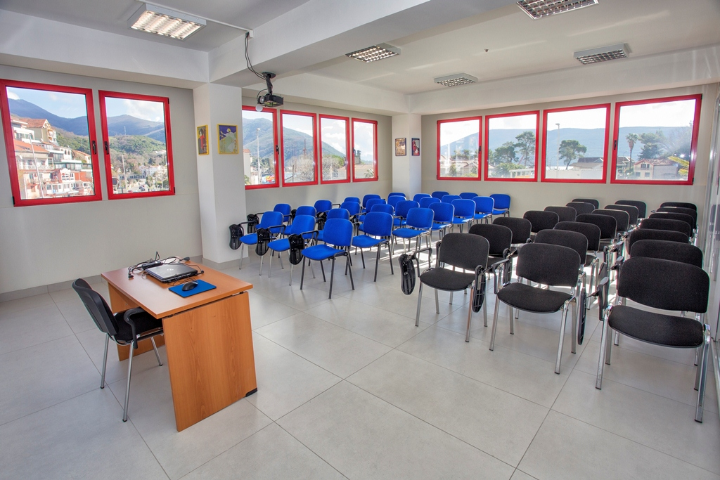
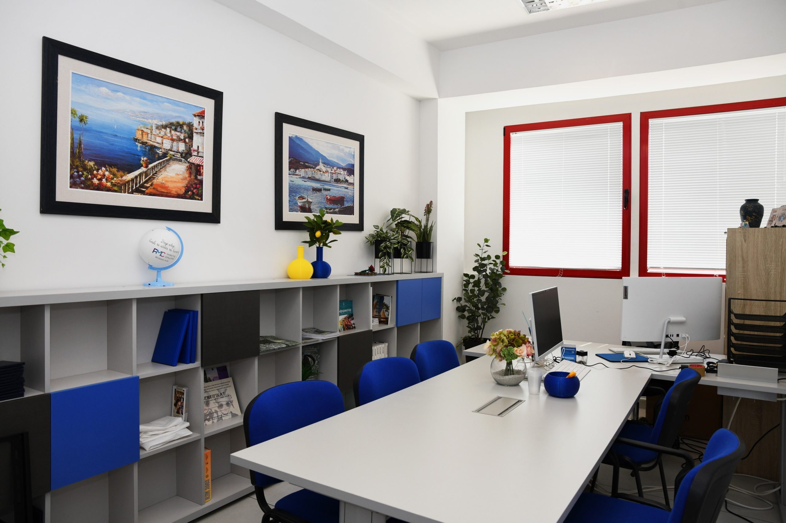
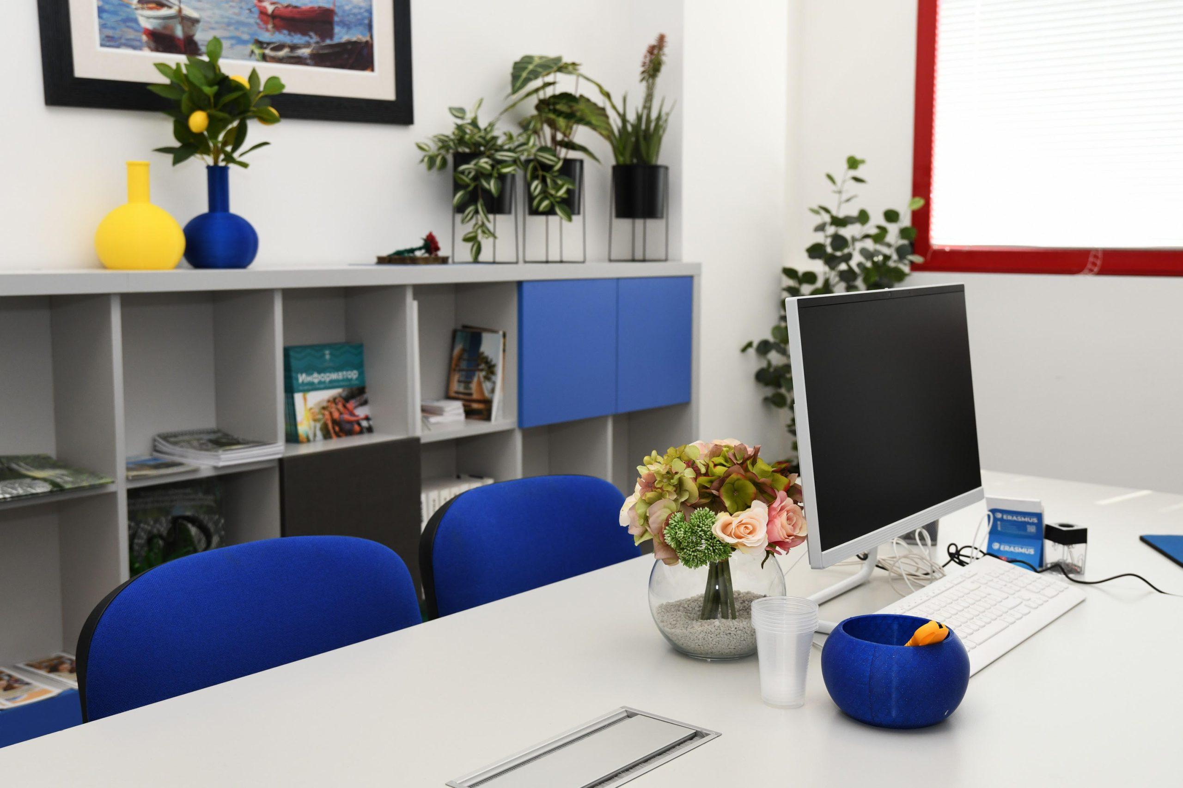
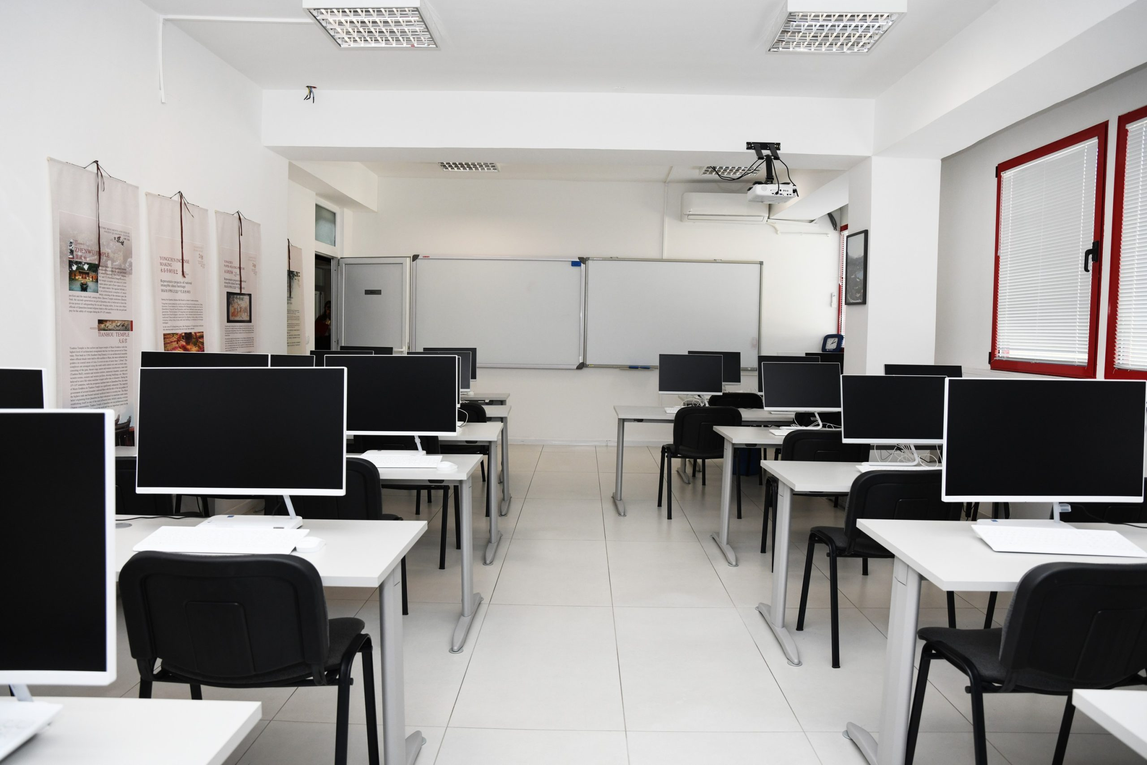
Faculty of Management Herceg Novi:

Slide 12


Thank You for Your Visit

